Slide 1

Project: AI-Enabled Smart Dairy Farm Submission ID:43
Team Members Name
1. Siva Reddy Vanga
2. Nagarjuna Reddy Thontla
3. Hari Sai Chand Bolla
4. Venkatesh Chalibindi

Slide 2
Agenda
1
Project Detail
2
Implementation Details
3
Complexities
4
Checklist

Slide 3
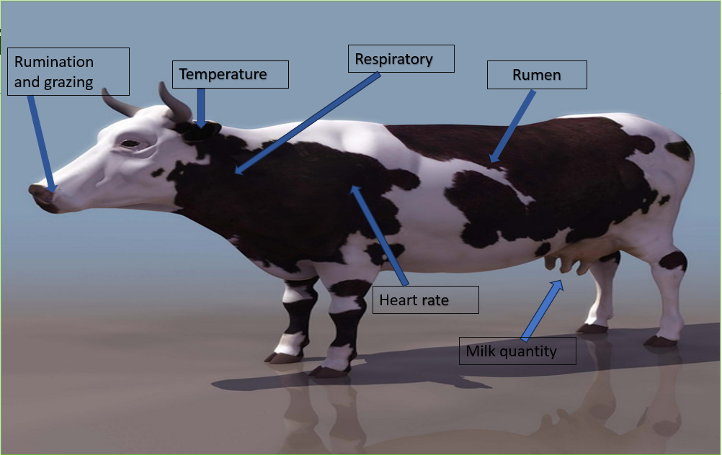

Objective
AI-Enabled Smart Dairy Farm
The dairy industry is a cornerstone of agriculture, providing essential products for human consumption. Within this industry, dairy cows' health and well-being are paramount. Ensuring the optimal health of cows directly impacts milk production, which affects the economic viability of dairy farming
Introducing an AI model built using STM32BL475EIOT1A board and deep learning to revolutionize the monitoring process. dairy cows' health and well-being are paramount.
To address this issue, In this project machine-learning model that can detect the health condition of cattle based on various parameters like body temperature, pulse rate, respiratory rate, rumen fill, etc.
, a
Figure 1: AI-powered Health Monitoring System for Cattle

Slide 4
Implementation Details
Data collection
Gather a comprehensive dataset containing information on health indicators of cattle, including body temperature, milk production, respiratory rate, and behavioral patterns.
Data Preprocessing
Cleaning: Handle missing values, outliers, and inconsistencies in the collected data to ensure data quality.
Categorical Encoding: Encode categorical variables using Label Encoding to convert them into numerical form.
Normalization: Standardize numerical features using Standard Scaling to bring them to a similar scale, ensuring fair treatment during model training
Data Collection
Data Preprocessing
Normalization
Model Architecture
Model Training
Split Dataset
Training
Model Evaluation
Prediction and Evaluation(Trained model)
C code generation using STM32CubeMXtool
Validation on STM32 IoT kit(B-L475EIOT01A)
Cleaning
Categorical Encoding
Figure 2:Methodology of AI Enabled smart dairy form

Slide 5
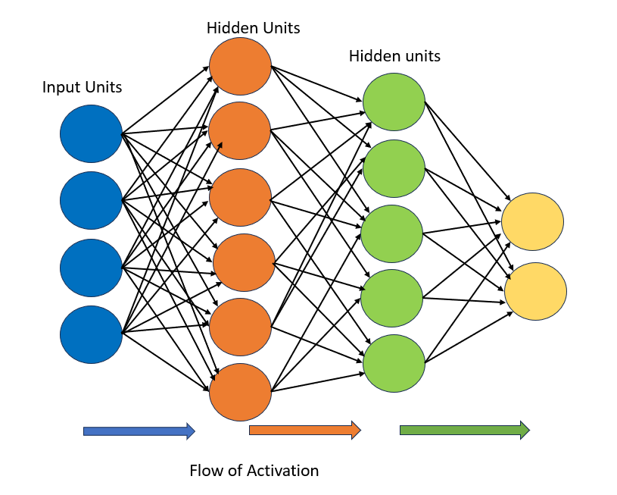
Implementation Details
Neural Network Architecture:
Input Layer (Dense): Size: 64 neurons Activation Function: Rectified Linear Unit (ReLU)
Hidden Layer (Dense): Size: 32 neurons Activation Function: Rectified Linear Unit (ReLU)
Output Layer (Dense): Size: Dependent on the number of classes in the target variable Activation Function:
Softmax (for multi-class classification using sparse categorical cross-entropy).
Model Training
Split Dataset: Divide the dataset into training and validation sets (80% training, 20% validation). •
Training: Train the model for 150 epochs with a batch size of 10 using the numerical features as input and the target variable (health status) for supervision.
Model Evaluation: Evaluate the model on the validation set to assess its performance in terms of loss and accuracy.
. Prediction and Evaluation • Generate predictions on the validation set and convert them to binary format based on a threshold of 0.5
• Generation of the C code for the model The model can feed to STM32 MX Tool. In that tool, we select a board after that we can feed the model and select the analysis and validation and it can generate c code for this model.
• Validation on target Set up an STM32 project in Cube IDE, select the microcontroller variant, and configure settings. Add ML libraries, integrate the model code, prepare input data, run inference, and validate results in Cube IDE. Debug and optimize the mode
Neural Network Architecture
Figure 3 : Neural Network Architecture of cattle health monitoring

Slide 6
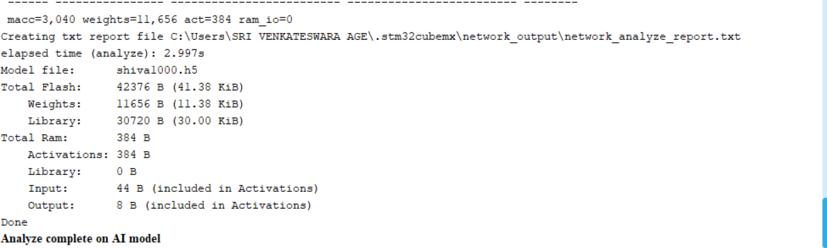
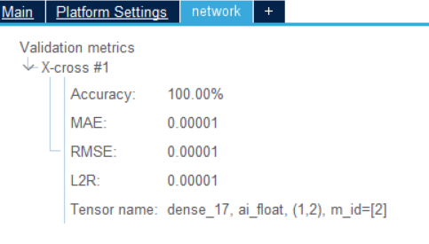
Results & Discussion
The project has completed the analysis and validation stages on the desktop environment. Additionally, the Automatic validation on the target has been successfully executed, and the generation of C code is also completed.
Total resource usage by the model ( ram/internal flash/external flash) and model size of project is 63.8KB
Figure 4: Ram and Flash of model
Figure 5:Validation metrics of the model in the STM32 Mx Tool

Slide 7
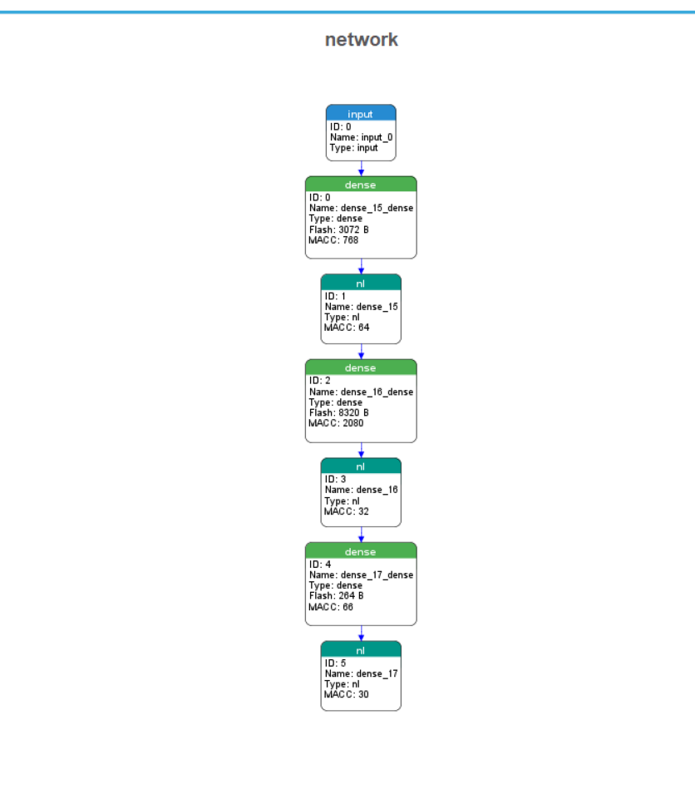
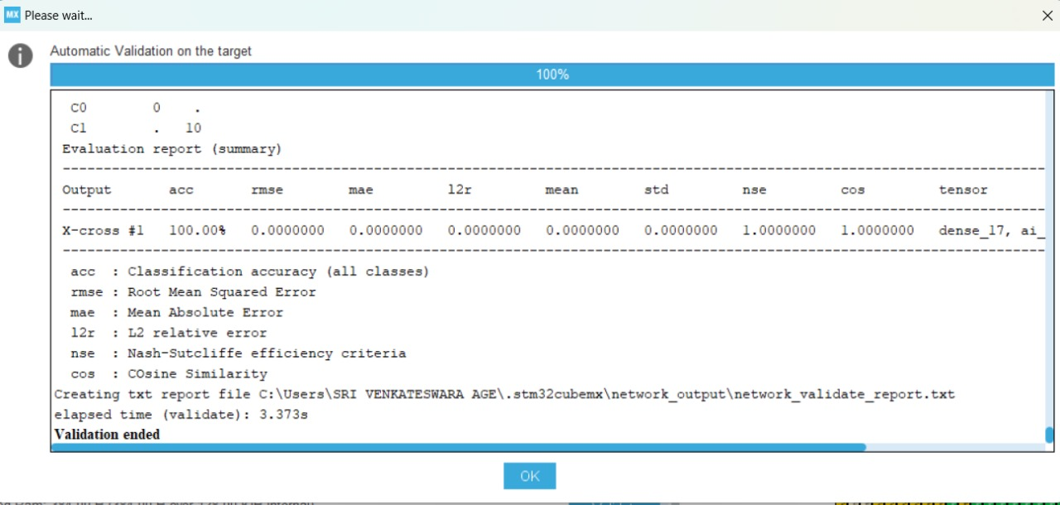
Cont.,
Automatic validation on target and Graph of model
Figure:6 Automatic validation on Target of model
Figure:7 ANN graph of model in STM32 Tool

Slide 8
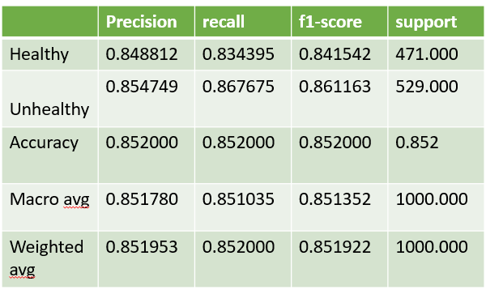
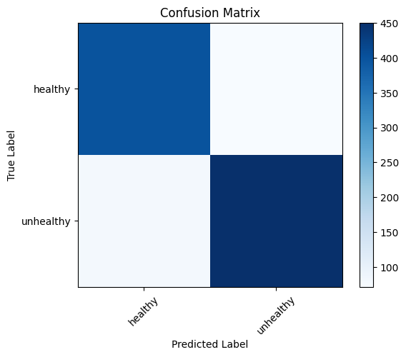
Cont.,
The Classification report and confusion matrix of the model
The model exhibits balanced performance metrics (accuracy 85.2%, precision 84.88%, F1 score 84.41%), crucial for applications needing a nuanced trade-off between precision and recall.
A Confusion matrix that summarizes the counts of true positive, true negative, false positive, and false negative predictions.
Figure 8: Classification report of model
Figure 9 :Confusion matrix of model

Slide 9
Checklist
List of Items to be submitted | Submitted (Yes / No)
AI model (.h5, .tflite, or .onnx) | Yes
Workspace of running application | Yes
PowerPoint presentation (max. 5 slides) about the application. | Yes
Details of any additional hardware boards used as companions to the kit provided by STMicroelectronics. | No
Training datasets used / created. | Yes
Any other relevant information, references, etc | Yes

Slide 10
References
Cow Health Prediction (kaggle.com)(datasets taken from the Kaggle)
STMicroelectronics (05 Jan 2022). X-cube-ai documentation. 2023
Mohammed Ismail1, Venkateswari, C. P. G. (March 2023). Animal health monitoring using machine learning. Bulletin of Environment, Pharmacology and Life Sciences, 12(4):4–7.

